Slide 1
The Expanded U-Diverse
January 25, 2014
The University of Alabama in Huntsville
Parrish L. Paul, Ph.D.
Director, Counseling and Disability Services
Susan L. Steen, Ph.D.
Director & Assistant Provost for International Engagement

Slide 2
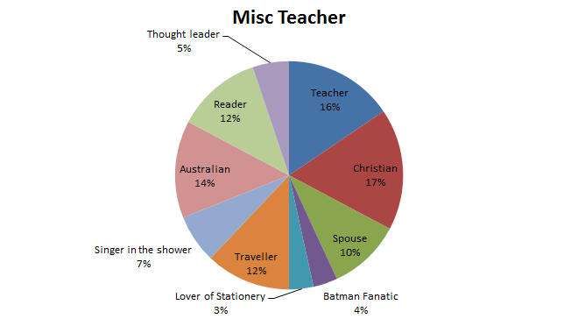
What are your identities?
Notes:
Pie Chart – Parrish
Feminist practice of grounding the content in our own identities
What is the lens we view the world through?
What is the context we work from?
If 100% of the pie is you, then how do you split up your identities?
Race/ethnicity, disability, religion, soccer player, etc.
Share with someone
Note for us: Our point will be that they are taking an active place in the room – not that they share something overly personal here

Slide 3
Diversity . . . and You and Me
How would you define diversity? When we talk about it, what do we mean? What does the term mean to you?
What forms does ‘diversity” take?
Let’s take a look at some forms of diversity in the world and in the US . . .
Notes:
Suzy – overview of diversity – 10 minutes
Includes If the World Were a Village of 100

Slide 4
If the World Were a Village
http://www.youtube.com/watch?v=FtYjUv2x65g
Notes:
Suzy – overview of diversity – 10 minutes
Includes If the World Were a Village of 100

Slide 5
The USA
http://quickfacts.census.gov/qfd/states/00000.html
Notes:
Suzy – overview of diversity – 10 minutes
Includes If the World Were a Village of 100

Slide 6
Diversity: Defined & Described
Merriam-Webster:
the quality or state of having many different forms, types, ideas, etc.
the state of having people who are different races or who have different cultures in a group or organization;
the condition of having or being composed of differing elements
variety; especially: the inclusion of different types of people (as people of different races or cultures) in a group or organization < e.g., programs intended to promote diversity in schools
Notes:
Suzy – overview of diversity – 10 minutes
Includes If the World Were a Village of 100

Slide 7
Diversity: Defined & Described
The Association of American Colleges & Universities describes diversity as
. . . individual differences (e.g., personality, learning styles, and life experiences) and group/social differences (e.g., race/ethnicity, class, gender, sexual orientation, country of origin, and ability as well as cultural, political, religious, or other affiliations)
Notes:
Suzy – overview of diversity – 10 minutes
Includes If the World Were a Village of 100

Slide 8
Why Do We Care? Why Should We Care?
Why is it an important concept to discuss/ understand/embrace in different contexts – in society, the workplace, university life, etc.?
In today’s global village/society:
It promotes personal growth - and a healthy society
Notes:
Suzy – overview of diversity – 10 minutes
Includes If the World Were a Village of 100

Slide 9
Why Do We Care? Why Should We Care?
In today’s workplace:
Diversity helps companies overcome talent shortages by enlarging their talent pools . . . helps them cope with globalization by expanding their cultural horizons . . . stimulates innovation by bringing together different sorts of people . . . (The Economist, January 21, 2014)
It enhances America's economic competitiveness. (ACE 2012)
It is crucial to doing business in a world whose populations are becoming increasingly interconnected (BusinessWeek, January 2011)
Notes:
Suzy – overview of diversity – 10 minutes
Includes If the World Were a Village of 100

Slide 10
Why Do We Care? Why Should We Care?
In Educational Institutions:
Diversity enriches the educational experience. (ACE, 2012)
Diversity prepares students to become good citizens in an increasingly complex, pluralistic society; it fosters mutual respect and teamwork (ACE, 2012)
It promotes socially responsible leadership development
Notes:
Suzy – overview of diversity – 10 minutes
Includes If the World Were a Village of 100

Slide 11
So… how do I become a more socially responsible, multiculturally competent, and effective leader?
Notes:
Suzy – overview of diversity – 10 minutes
Includes If the World Were a Village of 100

Slide 12
Thinking about issues of power and privilege….
Please stand and be prepared to move
around the room. You will not need pens
or paper for the next few minutes….
Notes:
Exercise – privilege and oppression – Suzy – 10 minutes
Line of inequity
Take out #3,4, 8, 9, 16, 19
The size and shape of the room may be a problem
QUESTIONS –
What did you think about this activity?
How did you feel about your position in the line?

Slide 13
Power, Privilege, and Oppression
“I was taught to see racism only in individual acts of meanness, not in invisible systems conferring dominance on my group” - Peggy McIntosh
How do racism, sexism, classism, ableism, heterosexism, and other “ism’s” create systems of oppression?
The “Invisible Knapsack”
This example may be focused on issues of race and White privilege, but we ask you to apply these ideas widely to issues of difference.
http://www.artsci.washington.edu/natsci/Search-committee-materials/unpacking-invisible-knapsack.pdf
Notes:
Asking you to consider issues of difference we are discussing today and how when they are enacted, it results in systemic oppression
People with power are granted privilege – to determine who is good, who is right, etc
When have you witnessed someone from a dominant or majority cultural group determining the worth or value of another person, based on the values of the dominant culture?
-examples – slavery, all Muslims being viewed as terrorists, etc.
What are you feeling in reaction to this?

Slide 14
Effective leaders will:
Translate ideas skillfully to diverse partners
Develop a meaningful understanding of and working relationship with colleagues
Increase knowledge of self
Expand knowledge of others
Develop culturally competent skills
Cultural meanings and values
Verbal vs. nonverbal cues/expectations
Culturally bound interpretations of social norms
Consider intersections of identity
And so on…
Intentionally include introspection
Notes:
Knowledge of self - how do your cultural experiences and beliefs bias you? How does your privilege or lack of privilege?
example – what have been the messages you have received about people on welfare? Has this informed your beliefs?
Knowledge of others
Am I really willing to expand my horizons? Do cultural immersion? Can I truly understand that my view may not be the “right” view?
Can I ensure that the knowledge of others is not biased? For example, all these studies done in colleges on white undergrads – do they really capture the experience of this country?
Develop skills…. Get training. In my field, multicul counseling classes and practicum. Find your options
Be intentional in your reflection

Slide 15
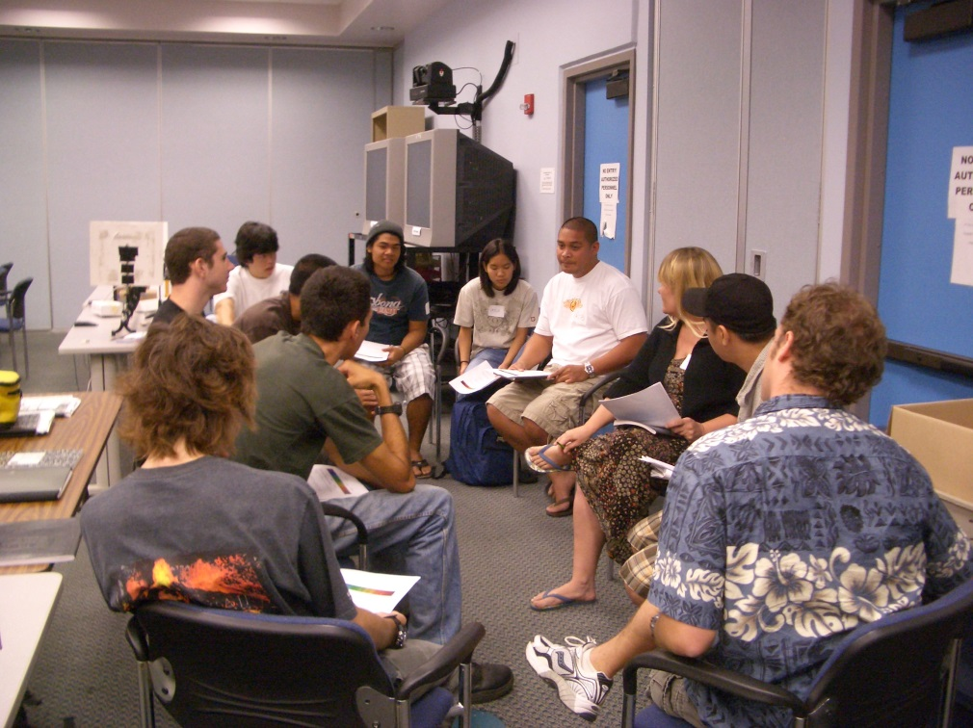
Narrative and group discussion
Notes:
What are you thinking/feeling?
Why is this article important in the context of our discussion today about diversity?
How could you envision this situation applying to other people in their own experiences of difference?
What are you holding back in this discussion, based on who is in the room?

Slide 16
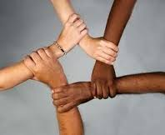
Hope Healing Closure Next Steps
Admit where you are.
Listen to other people.
Educate yourself.
Widen your experience.
Take action.
Notes:
Hope, healing, closure
If you want, what is your personal stake?

